Slide 1


Analysis of Monthly Energy Consumption by Customer Type and Zip Code in Nashville TN
By
Peter Busienei
Notes:
In this capstone ...
We define electricity intensity as electricity demand per person or dollar of economic activity. We argue that falling electricity intensity is driven largely by increased energy efficiency. Increases in efficiency across industrial, commercial and household sectors have arrested the growth in electricity consumption.

Slide 2
Facts
Tennessee is the headquarters of the TVA, a federal public power corporation that serves parts of seven southeastern states.
About half of Tennessee's electricity generating facilities, including the 10 largest power plants in the state, are owned and operated by the TVA.
The Tennessee Valley Authority (TVA) is the nation's largest public power corporation. It owns more than 90% of Tennessee's electric generating capacity and half the power plants, including the 10 largest power plants in the state.
Average price of electricity: 10.65 ¢/kWh
Average monthly usage: 1,238 kWh per customer (2nd highest)
Average monthly bill: $129 (7th highest)
Largest electricity source: Nuclear

Slide 3
Terms used by Nashville electric service
Residential: services for individual homes on permanent foundations, that are not part of a park.
Commercial: services to permanent commercial or industrial structures, outbuildings on residential property (barns, shops, pump-houses, garages, etc.), or any three-phase service whether it is for residential or commercial use.
Notes:
Tennessee is not far behind Louisiana in terms of energy usage, consuming an average of 14,856 kWh per household in 2016. Electric prices in the state ranked on the lower side of the spectrum (7th lowest in the nation), but conversely, state residents received the 7th highest bills.(according to choose energy.com)

Slide 4
Agenda
Classify consumers to different types
Analyze trends and total annual electric consumption
Analyze average annual energy consumption
Show average annual energy consumption per customer type
Show insights from the data for NES average energy consumption by zip code
The 10 highest and lowest energy consuming zip codes

Slide 5
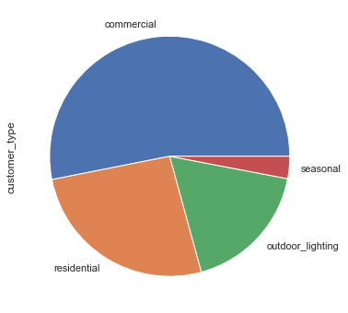
Who’s the highest consumer?
53.1%
3%
26.2%
17.7%

Slide 6
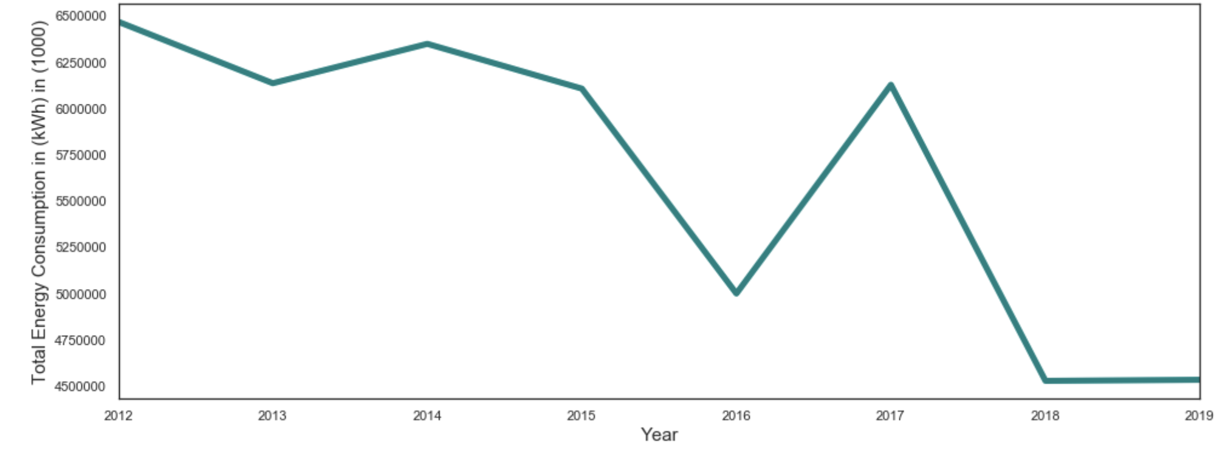
Total Energy consumption in Nashville city (2012-2019)
Notes:
Highest year being 2012, there is a decline trend lowest in 2019 as per the updated dataset on December 20, 2019

Slide 7
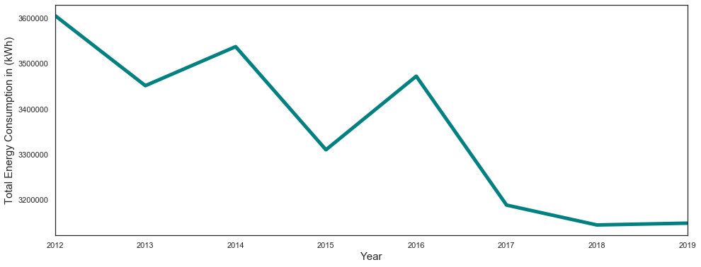
Avg annual energy consumption in (kWh)
Notes:
Decline in average energy consumption

Slide 8
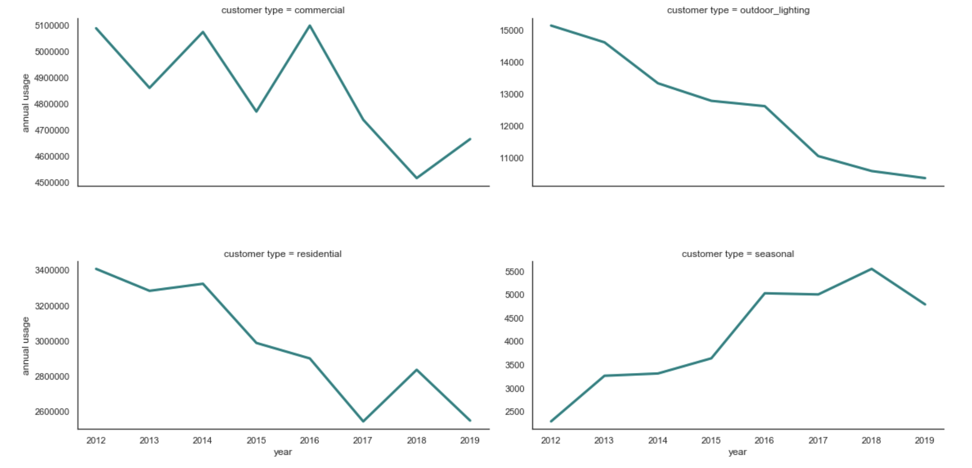
Avg annual energy consumption by customer type

Slide 9
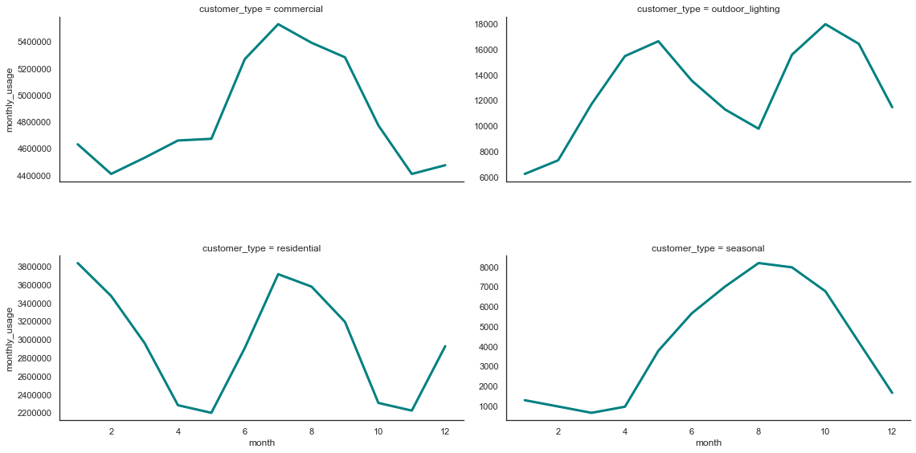
Avg monthly energy consumption by customer type

Slide 10
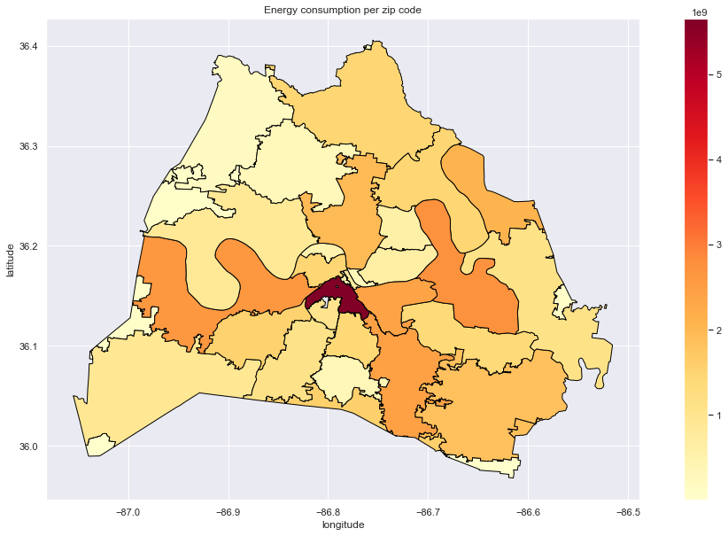
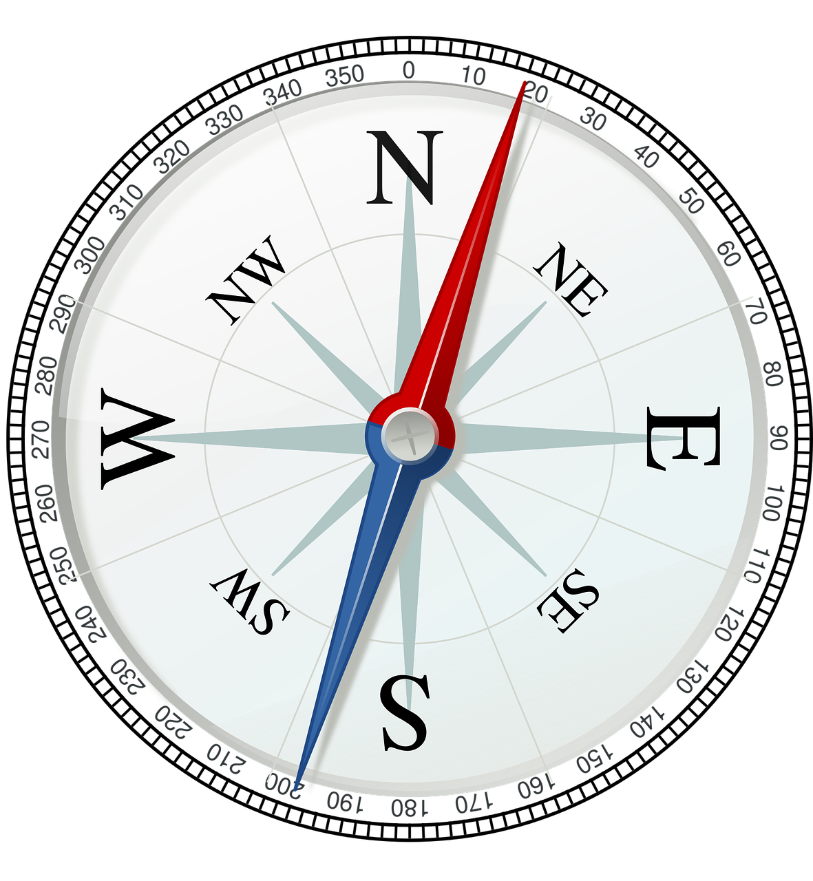
Total energy consumption per zip code
NSS
Notes:
What’s happening in 37203?

Slide 11
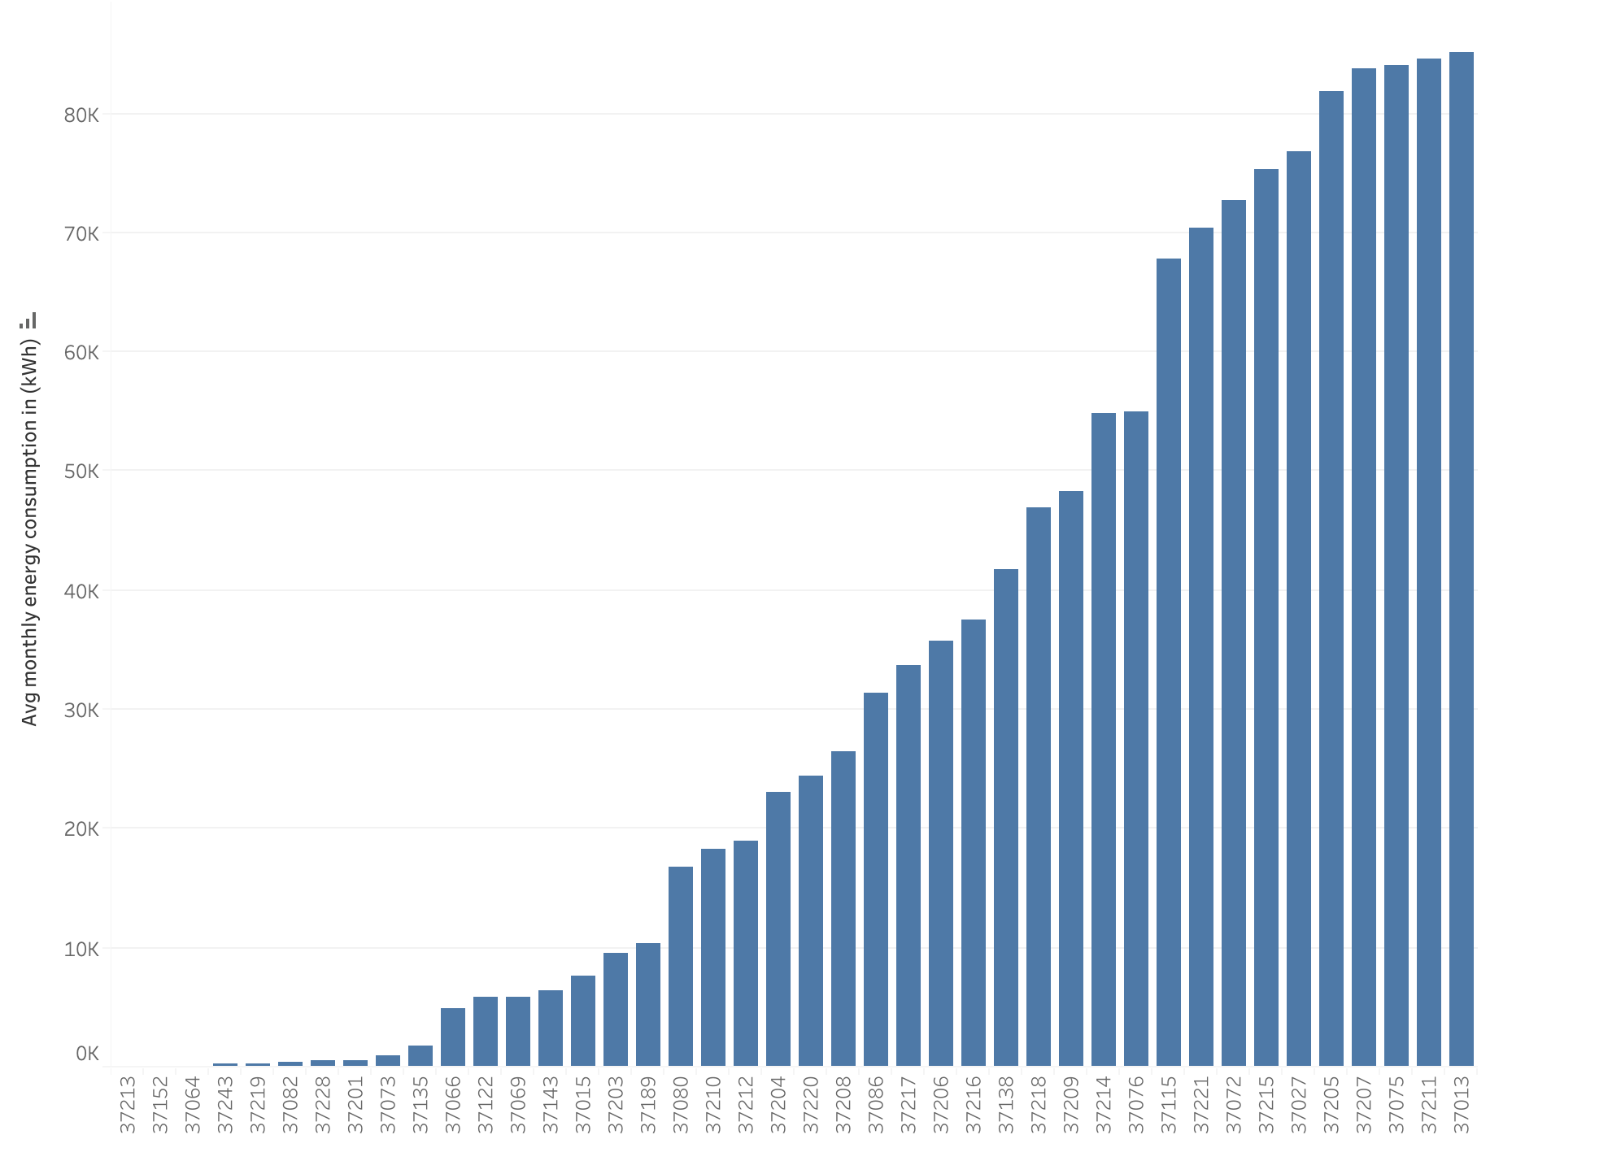
Avg monthly energy consumption per zip code
Zip code
Notes:
Average annual electricity consumption for a U.S. residential utility customer was 10,972 kilowatthours (kWh), an average of about 914 kWh per month. Tennessee had the highest annual electricity consumption at 15,394 kWh per residential customer as per U.S. Energy information administration.

Slide 12
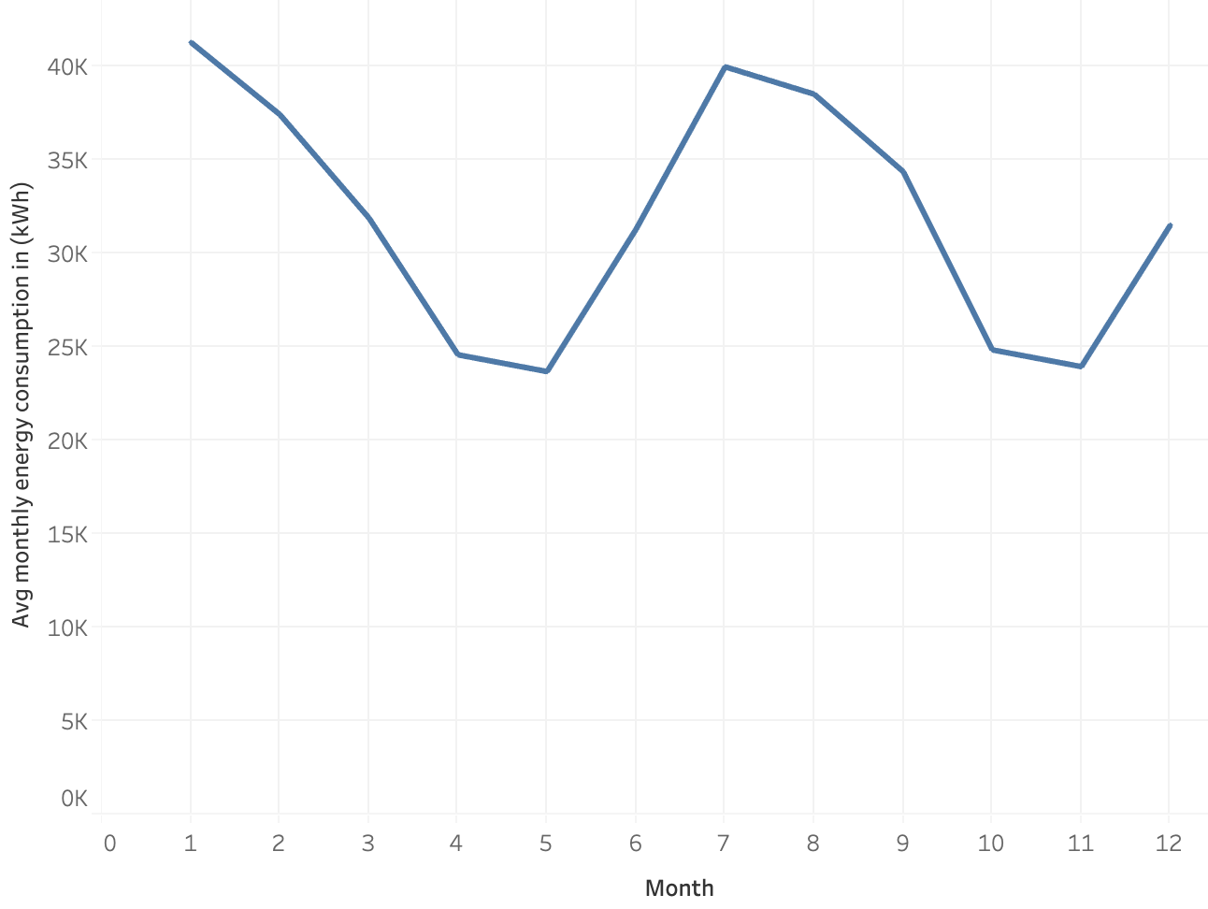
Residential energy consumption per month

Slide 13
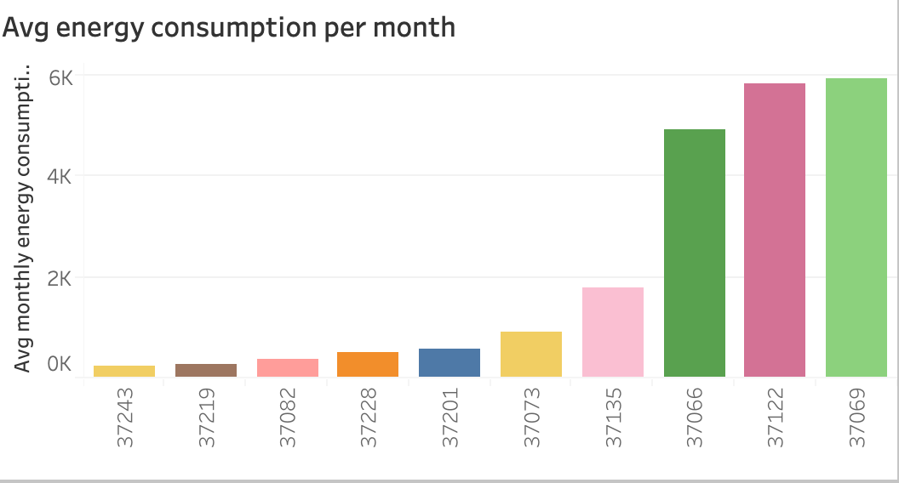
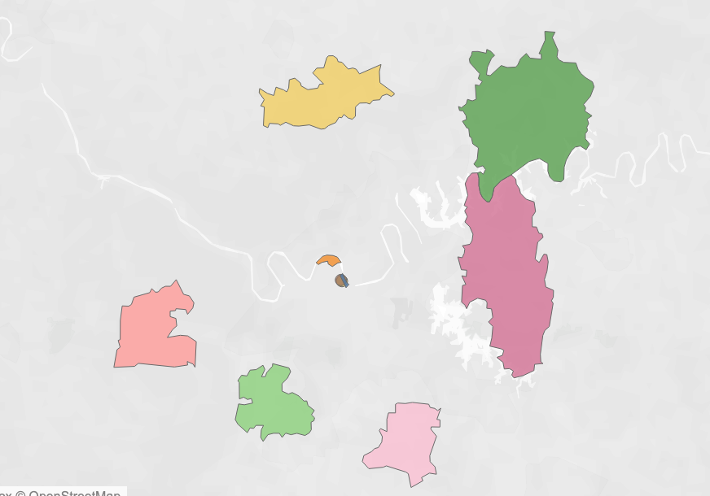
Lowest energy consuming zip codes

Slide 14
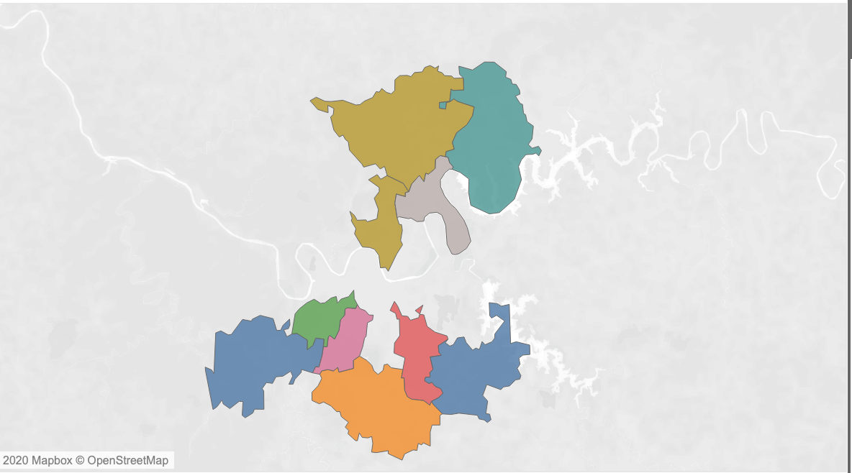
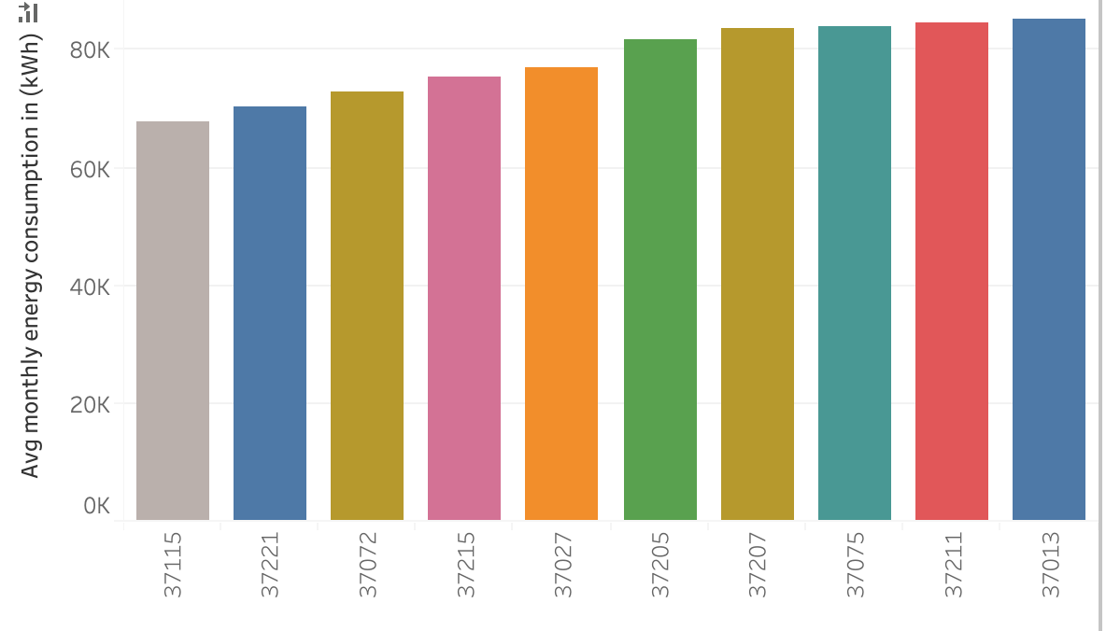
Top 10 energy consuming zip codes

Slide 15
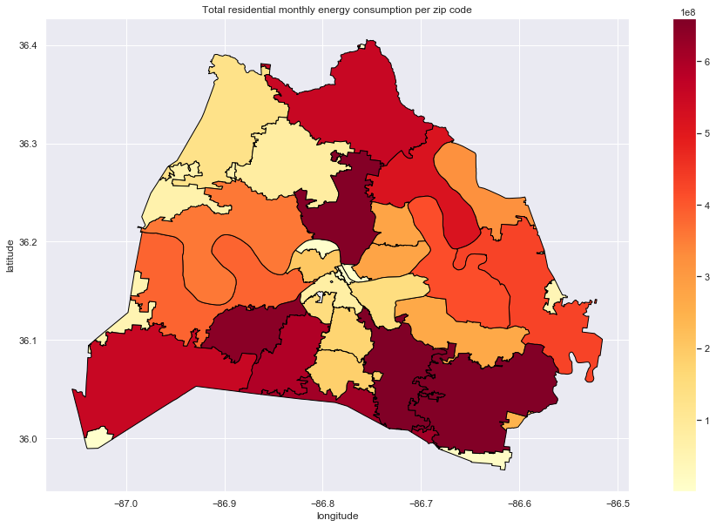
Where is more energy consumed?

Slide 16
References
Data.Nashville.gov(https://data.nashville.gov/Energy-Usage/NES-Monthly-Energy-Consumption-by-Customer-Type-an/vbx7-mn5i)
U.S. Energy Information administration( https://www.eia.gov/)
United States zip codes(https://www.unitedstateszipcodes.org/)
Choose energy (https://www.chooseenergy.com/news/article/the-states-that-use-the-most-and-least-amount-of-energy-per-household/)
Statistica (https://www.statista.com/statistics/807951/average-monthly-electricity-usage-in-major-us-cities/)

Slide 17
Thank You!

Slide 18
Tableau Viz
https://public.tableau.com/profile/bush1897#!/vizhome/EnergyConsumption_15781937576950/Mydashboard?publish=yes

Slide 19
Appendix

Slide 20
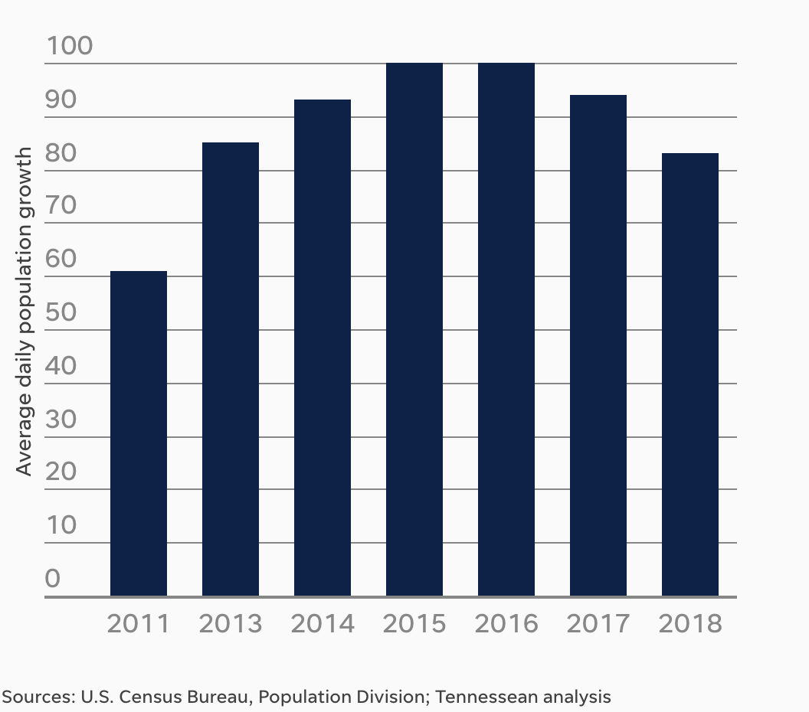
Nashville daily avg population growth

Slide 21
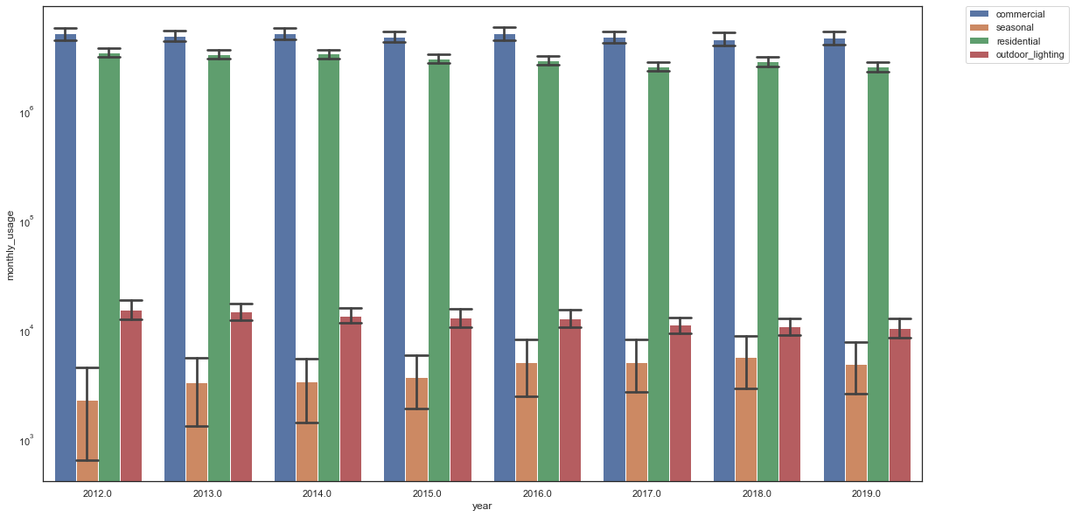
Energy consumption trends over the years
Notes:
SD error bars

Slide 22
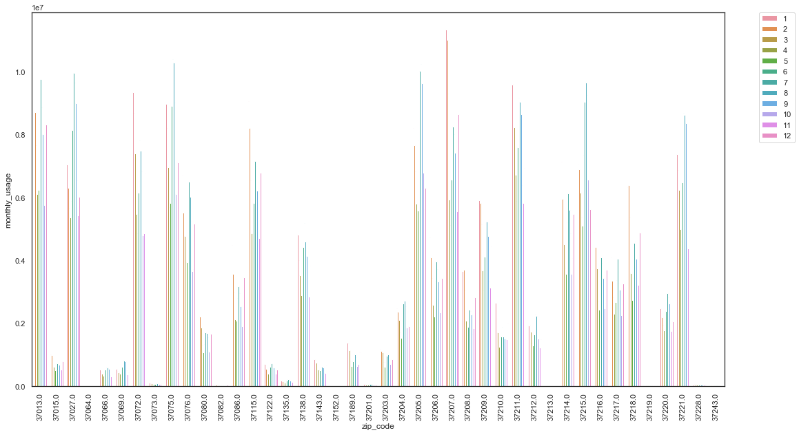
Residential monthly energy consumption
Notes:
Line plot could be better
Annual avg of each zip code

Slide 23
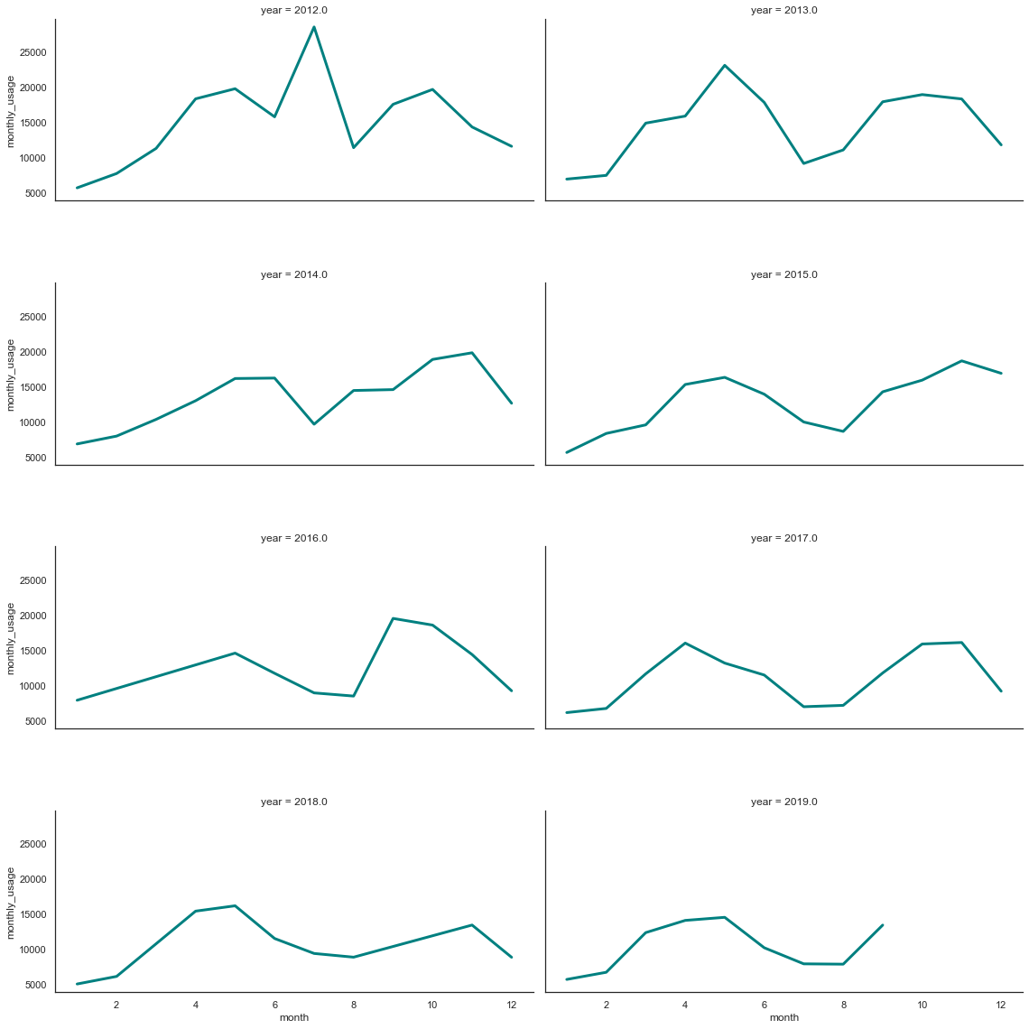
Monthly energy consumption per year ermonth

Slide 24
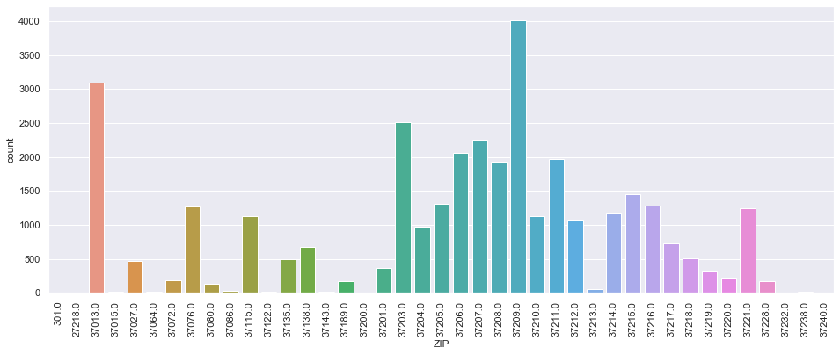
Total building permits issued
Notes:
Permits issued between 2015

Slide 25
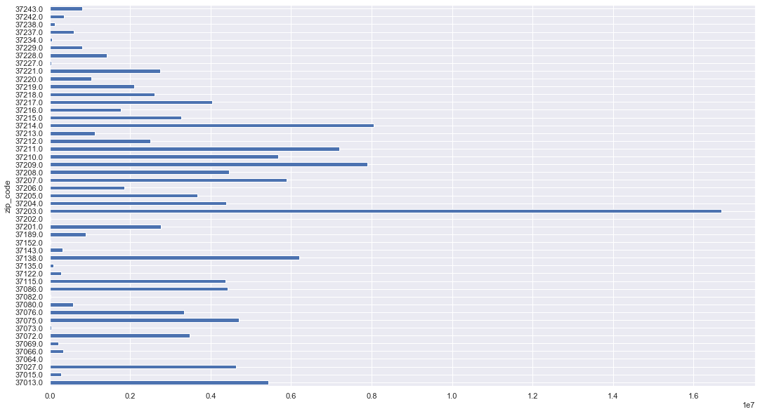
Total energy consumption per zip code

Slide 26
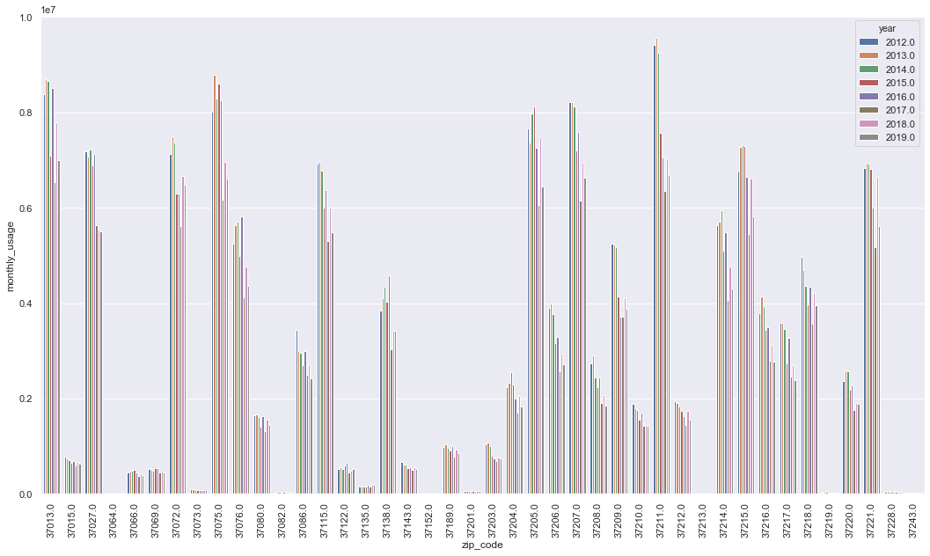
Residential annual energy consumption per zip code
Notes:
2012/2018 comparison graph
Average annual electricity consumption for a U.S. residential utility customer was 10,972 kilowatthours (kWh), an average of about 914 kWh per month. Tennessee had the highest annual electricity consumption at 15,394 kWh per residential customer as per U.S. Energy information administration.

Slide 27
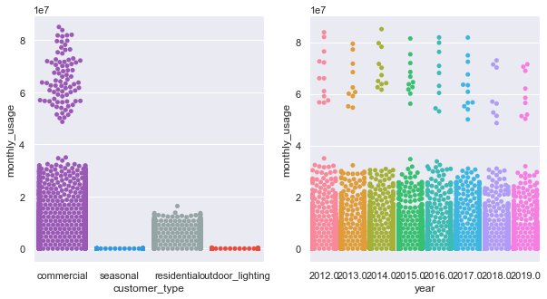

Slide 28
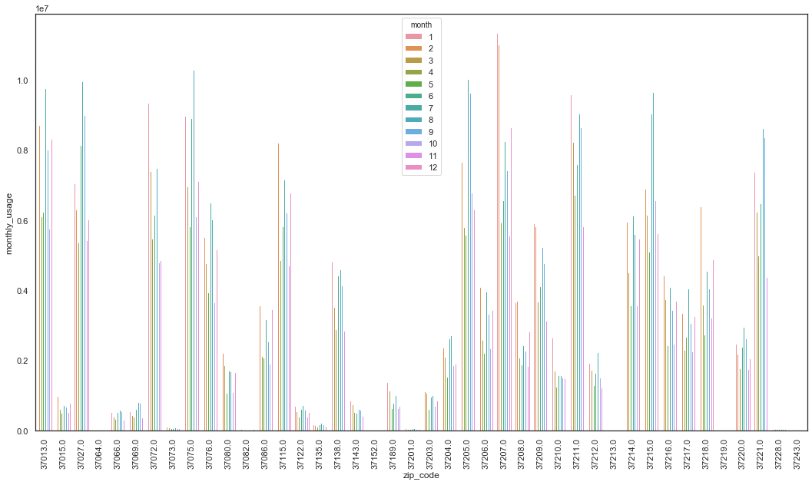
residential

